Slide 1
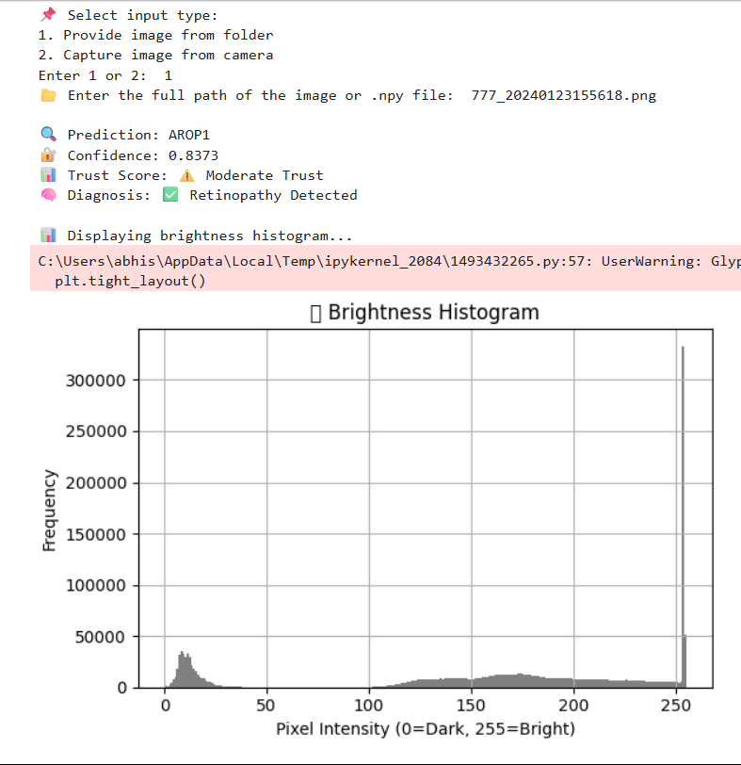
CP301
Leveraging Biobanks and Blockchain for Early Detection and Management of Retinopathy of Prematurity (ROP)
By ABHISHEK KUMAR
GOWTHAM RAJU
Dr . NEHA SARDANA
1

Slide 2

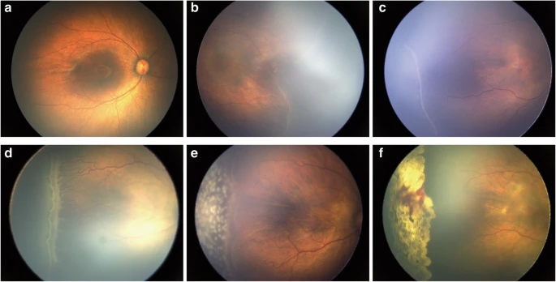
Introduction
Early detection of Retinopathy of Prematurity (ROP) in premature infants
Uses fine-tuned ResNet18 CNN model
Classifies retinal images into NORMALROP, AROP1, and AROP2
Trained on preprocessed retinal images for improved accuracy
Brightness histogram visualization of input images
calculation to assess model confidenceUsing Confidence matrix
Real-time webcam-based image capture for live diagnosis
Combines computer vision, deep learning, and medical imaging
Fast, reliable, and portable ROP screening solution
Deployable in hospitals and rural healthcare centers
Demonstration of various kinds of Ratinal images. (a), normal image; (b), stage 1 ROP; (c), stage 2 ROP; (d), stage 3 ROP; (e), image with fresh laser scars; and (f), image with stable laser scars.
fig . 1
2

Slide 3
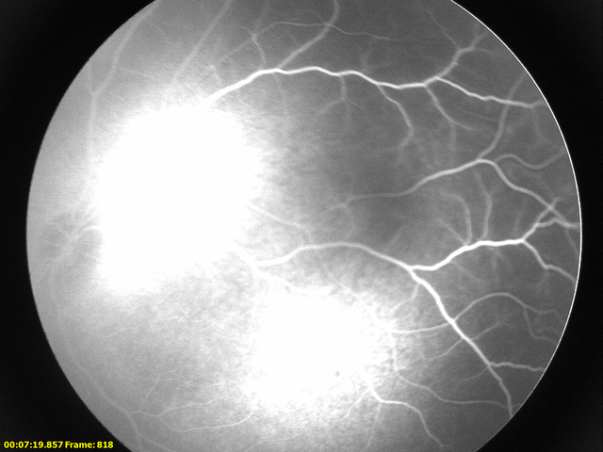
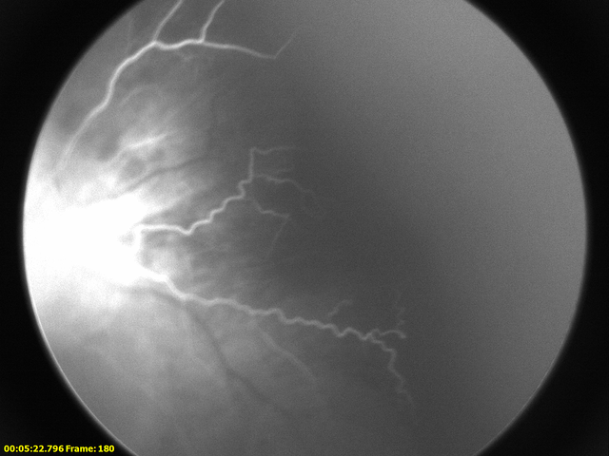
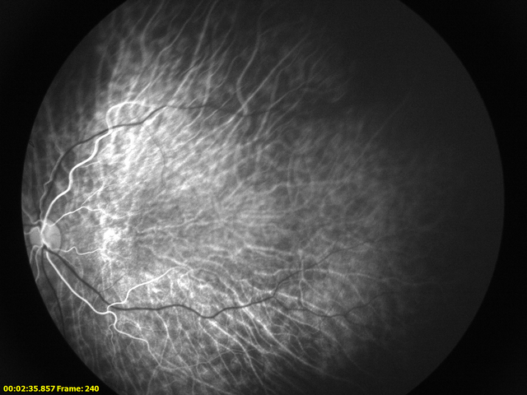
OBJECTIVE
Objective Of this Project
The primary goal of this project is to develop a machine learning model that can predict early symptoms of retinopathy in humans by analyzing retinal images. By leveraging a dataset from a Human Retinopathy Biobank, the project aims to facilitate early diagnosis and intervention, potentially preventing the progression of retinopathy and reducing the risk of vision loss.
Dataset Provided
We have provided Three set of Rop images named AROP1, AROP2, and NORMAL ROP
AROP1
fig . 2
Normal ROP
fig . 4
3
AROP1
fig . 3

Slide 4
Difference between the AROP1, AROP2, and NORMALROP
CONTENT | NORMALROP | AROP1 | AROP2
Brightness & Contrast | Balanced brightness and contrast, showing detailed vessel structures naturally | Higher brightness with well-defined vascular structures. Some areas appear overexposed. | Lower brightness and contrast. The vascular structures are faint and less prominent.
Pixel Density (Vascular Sharpness) | Highest edge density, meaning well-defined and naturally strong vascular structures. | Moderate edge density, with clear but slightly blurred vessel structures. | Lowest edge density, indicating weak vascular structures.
Clarity and Potential ROP Severity Indications | Clearly visible and well-defined vessel networks. | Somewhat visible but slightly diffused vessel patterns. | Vessels appear more fragmented and less structured.
4

Slide 5
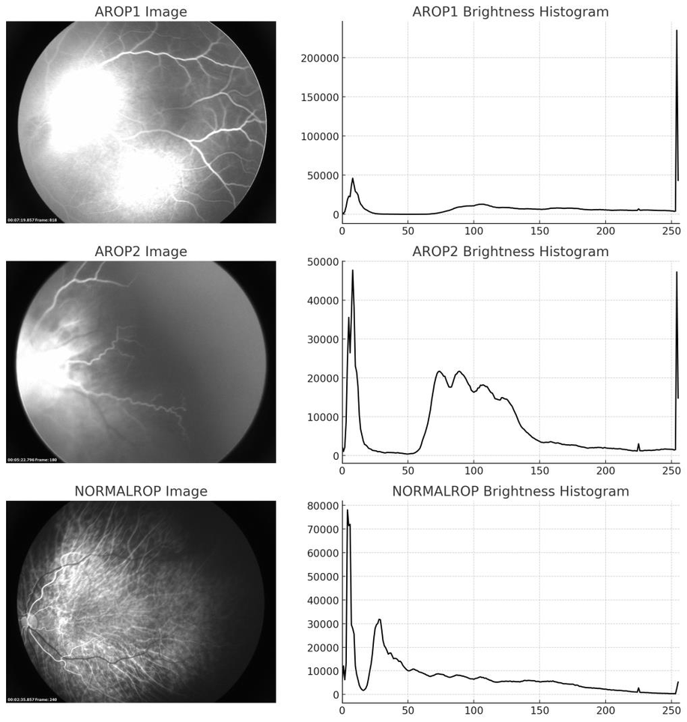
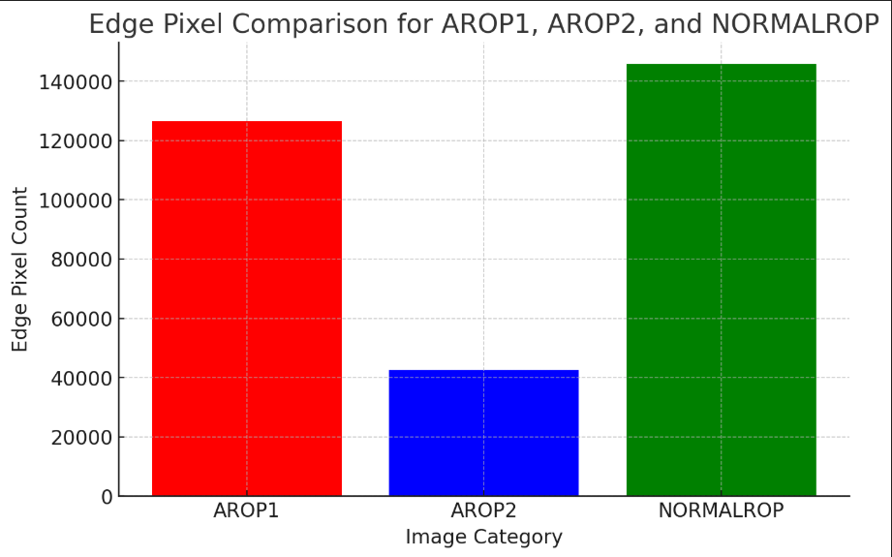
GRAPH SHOWING THE DIFFERENCE
fig . 5
Edge Pixel Comparision for AROP1 , AROP2, AND NORMALROP
5

Slide 6

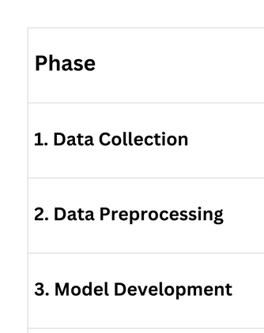
Road Map to the project
6

Slide 7
PREPROCESSING OF DATASET
Self Supervised Learning (SSL)
What is Image Preprocessing?
A crucial step to convert raw image data into a clean and consistent format suitable for deep learning models.
Enhances image quality, standardizes input shape, and improves learning efficiency and accuracy.
Why is it Used in This Project?
Retinal images from different classes vary in resolution, illumination, and noise levels.
Our CNN model (ResNet18) requires uniform image size (224×224) and normalized input values.
Ensures consistent input format for effective training and reliable predictions across AROP1, AROP2, and NORMALROP classes.
Preprocessing Steps Performed
Loaded raw images from the ROPTEST3 dataset (AROP1, AROP2, NORMALROP).
Converted images to RGB format for consistent color representation.
Resized images to 224×224 pixels to match CNN input dimensions.
Normalized pixel values to the [0, 1] range for stable model training.
Saved images as .npy files for efficient and faster loading during model training.
7

Slide 8
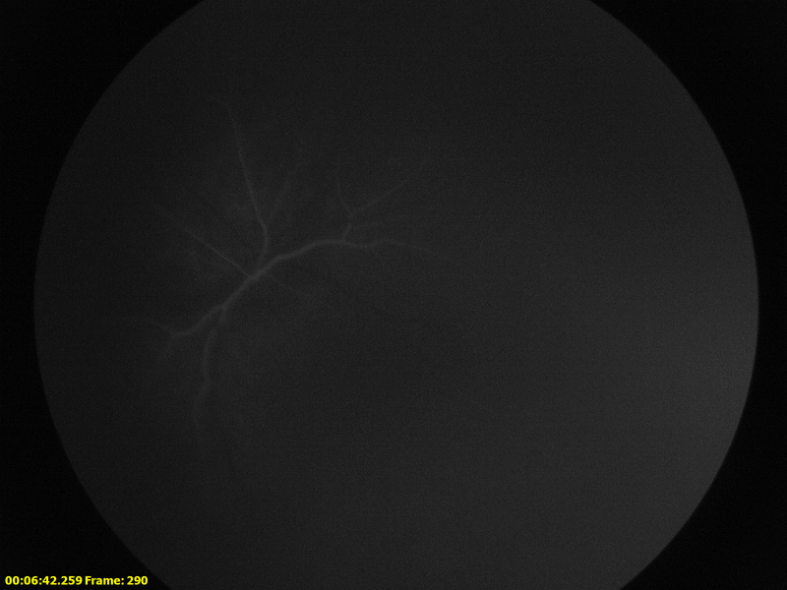
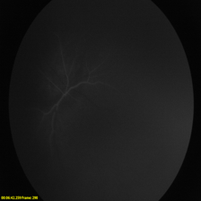
Result of Data Preprocessing
fig . 6
Before Preprocessing
fig . 7
After Preprocessing
8

Slide 9
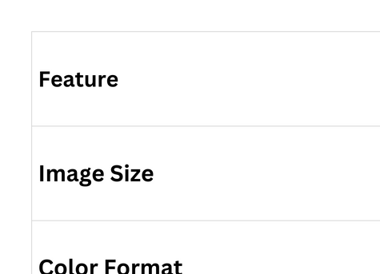
Result of Data Preprocessing
9

Slide 10
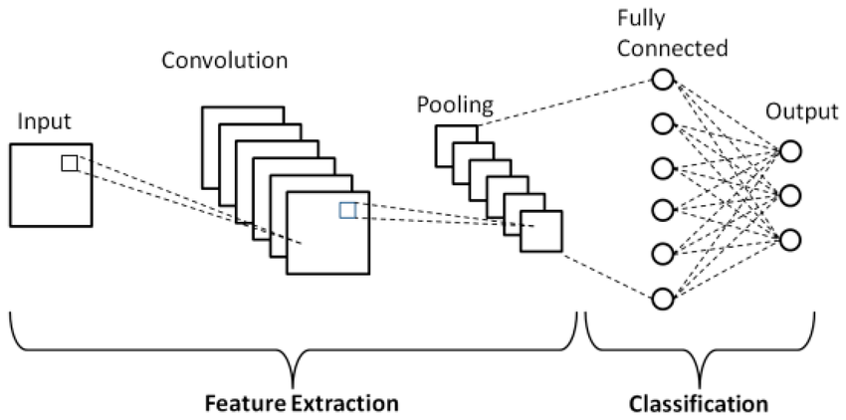
MODEL DEVELOPMENT
Loaded preprocessed .npy images using a custom ROPDataset class.
Mapped folder names to class labels: NORMALROP, AROP1, AROP2.
Converted grayscale images to RGB (3 channels) for CNN compatibility.
Applied transformations:
Resized images to 224×224 pixels.
Converted images to PyTorch tensors.
Split dataset into:
80% training set
20% testing set
Used DataLoader for efficient mini-batch training (batch size = 32).
Applied Transfer Learning with pretrained ResNet18 model.
Replaced final layer of ResNet18 to predict 3 output classes.
Used CrossEntropyLoss as the loss function.
Used Adam Optimizer with learning rate = 0.0001.
Trained the model for 10 epochs on GPU (if available).
Saved the trained model as rop_model.pth for future predictions.
fig . 8
ResNet-18 Architecture
Schematic diagram of a basic convolutional neural network (CNN) architecture
10
https://www.researchgate.net/figure/Schematic-diagram-of-a-basic-convolutional-neural-network-CNN-architecture-26_fig1_336805909

Slide 11
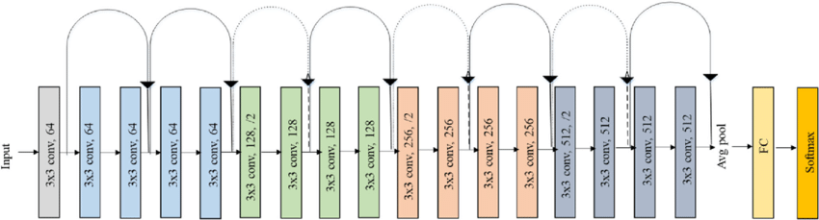
METHODOLOGY
Why .npy Format?
.npy is NumPy’s binary format — highly efficient for storing large numerical arrays like images.
Faster loading time during training compared to reading raw image files (e.g., .jpg, .png).
Ensures data consistency and removes file decoding overhead.
Ideal for deep learning pipelines, where quick I/O(Input/Output) operations can speed up training time.
Why ResNet18?
ResNet18 is a Convolutional Neural Network (CNN) with residual connections to avoid vanishing gradients.
Provides deep feature extraction while maintaining a relatively small model size.
Pretrained on ImageNet, which transfers general visual knowledge to retinal image classification.
Suitable for medical image tasks with limited data — boosts performance without overfitting.
Faster and lighter than deeper models (ResNet50, ResNet101), making it ideal for real-time applications.
11

Slide 12
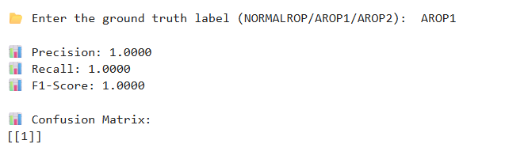
Model Evaluation Metrics
Accuracy
Measures the overall correctness of the model’s predictions across all classes (NORMALROP, AROP1, AROP2).
Cross-Entropy Loss
Evaluated during training to measure how well the model's predicted probability distribution matches the true labels.
Confusion Matrix
Visualizes the number of correct and incorrect predictions for each class, helping to identify misclassifications.
Mean Squared Error (MSE)
Used as a confidence/trustworthiness metric to measure the squared difference between predicted class probabilities and the actual label.
→ Lower MSE indicates more confident and reliable predictions.
12

Slide 13
RESULTS
Image Input: Users can either select an image from the dataset (e.g., .npy format) or capture a new image using a webcam.
Model Prediction:
The trained ResNet-18 model (with custom output layer for 3 classes: NORMALROP, AROP1, AROP2) is used to predict the class of the input image.
Confidence Score:
The model outputs softmax probabilities, and the highest score determines the predicted class along with a trust level (high, moderate, low).
User-Defined Ground Truth:
After prediction, the user manually enters the actual label (ground truth) for the image, enabling one-by-one evaluation.
Evaluation Metrics:
Using scikit-learn:
Precision: Measures the accuracy of positive predictions.
Recall: Measures how well the model identifies all relevant cases.
F1-Score: Harmonic mean of precision and recall.
Confusion Matrix:
A confusion matrix is generated to visualize how well the predicted labels match the actual labels.
Brightness Histogram:
A brightness histogram is plotted for each image to visualize pixel intensity distribution — helps correlate image quality with prediction accuracy.
13

Slide 14
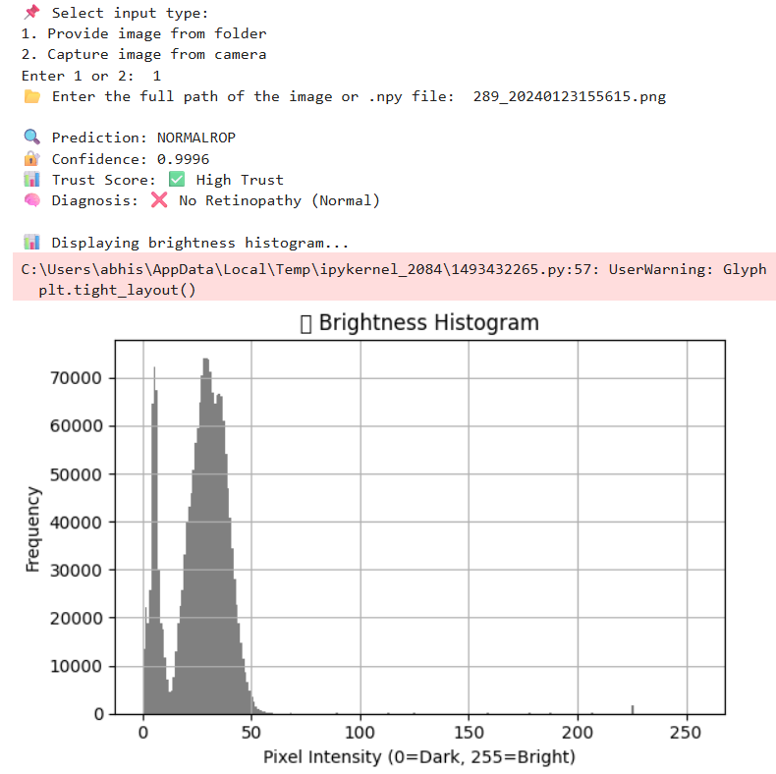

RESULTS
fig . 9
The Preprocessed input image fed to the model
fig . 10
The Output predicted by the model indicates that there is no ROP with Confidence of 99.976 %
14

Slide 15
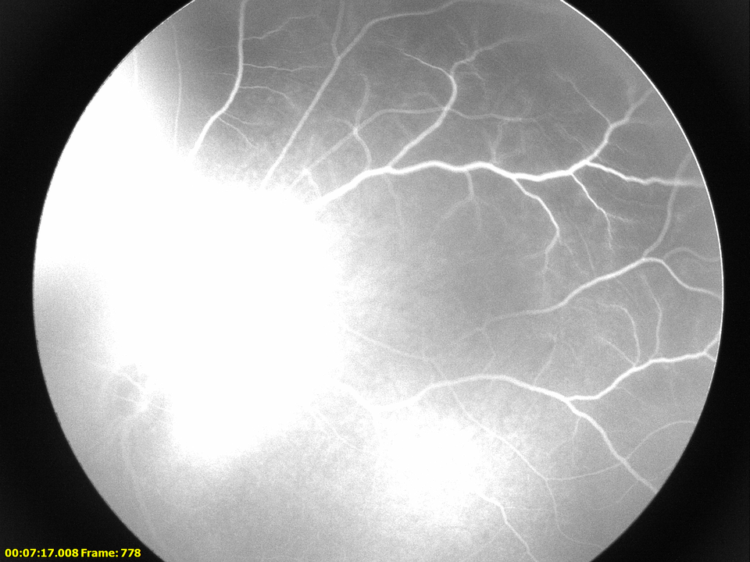
RESULTS
fig . 11
The Preprocessed input image fed to the model
fig . 12
The Output predicted by the model indicates that there is ROP with Confidence of 83.73%
15

Slide 16
Results Interpretation & Insights
High Accuracy on Test Samples:
The model consistently predicted correct classes for test images, especially for well-preprocessed .npy images.
Confidence-Based Trust System:
Each prediction included a confidence score, allowing doctors or users to interpret how reliable the result is (High, Moderate, Low trust).
Brightness Influence:
Brightness histogram analysis indicated that poor lighting or extreme contrast could affect prediction confidence.
Model Strength:
ResNet18 performed well due to transfer learning from ImageNet — even with limited dataset size.
Limitation Noted:
Manual ground truth input limits real-time evaluation; integrating a labeled test set in bulk would improve metric reliability.
16

Slide 17
Ethical Considerations in Medical AI
Patient Data Privacy:
No personal or identifiable data was used — only anonymized, preprocessed image arrays in .npy format were handled to ensure privacy.
Transparency in Predictions:
The model displays prediction confidence and a trust score, promoting user awareness and informed medical interpretation.
No Autonomous Diagnosis:
This AI tool is intended to support, not replace, professional medical diagnosis — decisions should always be made by qualified healthcare experts.
Bias Awareness:
Model performance may vary across unseen patient demographics; care must be taken before clinical use or generalization.
Accountability & Safety:
Regular evaluation, expert feedback, and version control are essential to ensure safety, reduce errors, and avoid unintended harm.
17

Slide 18
LIMITATION OF THE MODEL
Small & Limited Dataset:
The model was trained on a modest number of .npy images, which may not fully capture real-world variability.
Camera Input Constraints:
Webcam-based images lack consistency in lighting and angle, possibly affecting model predictions.
No Real-Time Feedback Loop:
Current system lacks automated retraining based on incorrect or evolving diagnosis patterns.
Single-Model Dependency:
Only ResNet18 was explored; other architectures might perform better or be more efficient.
18

Slide 19
FUTURE DEVELOPMENT OF THE MODEL
Blockchain-Backed Model Deployment:
Securely deploy the trained model on a decentralized platform.
Ensure tamper-proof logs of predictions and updates.
Enable auditable access control for healthcare professionals.
Provide patient data traceability without compromising privacy.
Explore Other Deep Learning Models:
Use DenseNet, EfficientNet, or lightweight mobile models for edge deployment.
Collect Larger Annotated Dataset:
Gather diverse and labeled ROP image data for better generalization.
Implement Continuous Learning Loop:
Add a mechanism for expert feedback and incremental model retraining.
Cloud + Mobile Integration:
Enable real-time diagnosis support on mobile apps, with cloud-based storage and computation.
19

Slide 20
Future Work: Blockchain-Enabled Deployment for Secure ROP Detection
Why Blockchain?
Ensures data integrity, transparency, and immutability.
Protects patient data and model usage from tampering.
Enables traceable access logs and verifiable model predictions.
Blockchain Deployment
Deploy Model Hash & Smart Contract , After training the model, we generate a cryptographic hash of the model (a unique digital fingerprint).
This hash is stored on a blockchain using a smart contract, ensuring:
The model cannot be tampered with after deployment.
Anyone can verify the model’s authenticity by checking its hash on-chain.
Log Prediction Requests and Outcomes Immutably
Every time a user (like a doctor) makes a prediction using the model:
The input request, timestamp, predicted result, and confidence score are logged as a blockchain transaction.
This creates a permanent, tamper-proof audit trail—helpful for regulatory compliance, accountability, and trust in clinical settings.
20

Slide 21
CONCLUSION
This project presents an AI-driven diagnostic tool for Retinopathy of Prematurity (ROP), combining the power of deep learning and medical imaging.
By preprocessing images and using .npy format, we ensured efficient loading and consistent training input, making the pipeline robust and scalable.
The choice of ResNet18 provided a balanced trade-off between accuracy, speed, and computational efficiency, enabling real-time diagnosis with high confidence.
A novel Trust Metric was integrated using prediction confidence, aiding clinical decisions with a layer of interpretability and risk assessment.
The deployment pipeline includes webcam/image input, brightness histograms, and trust scoring, making the tool practical and user-friendly for real-world healthcare settings.
Future integration with blockchain-backed infrastructure opens pathways for secure, traceable, and ethical AI deployment in medical diagnostics.
21

